Slide 1
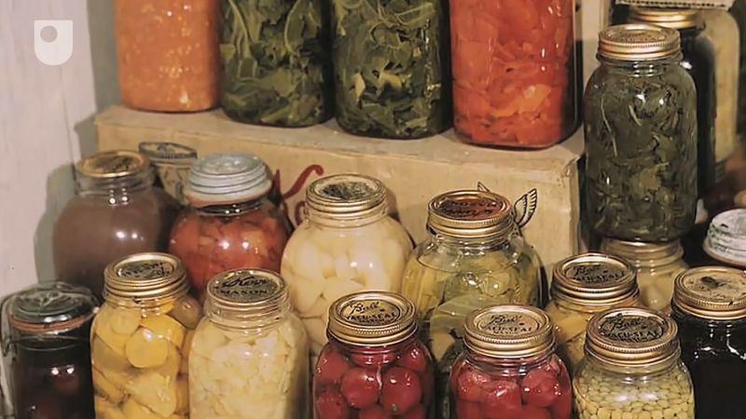
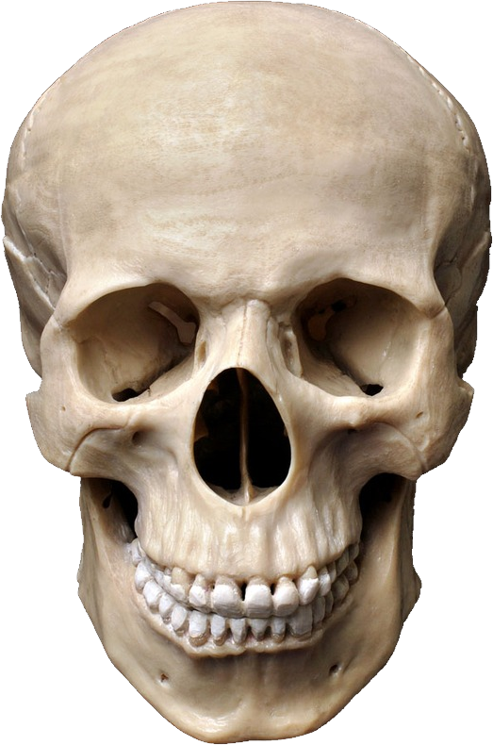

The Importance of Food Preservation Technology
Science Year 6

Slide 2
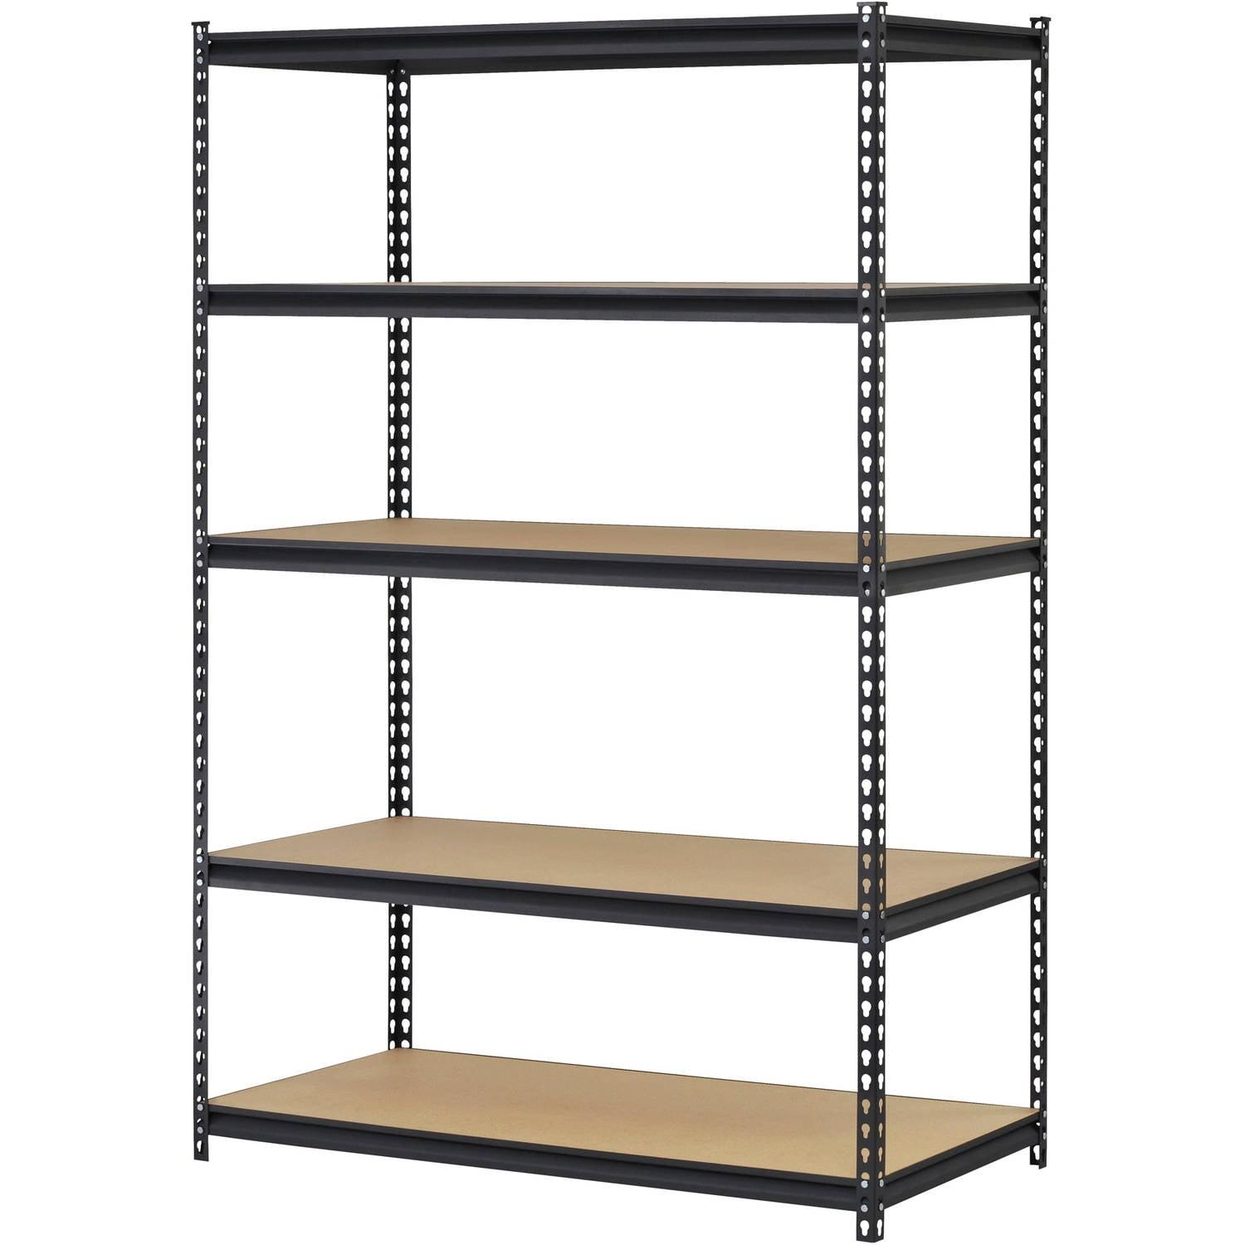
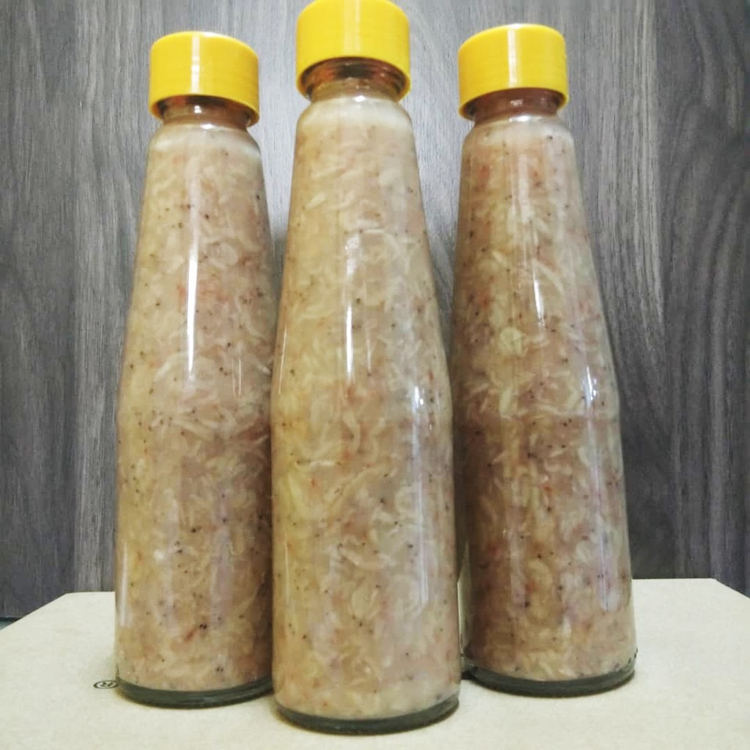

Food has a longer shelf life
Preserved food can last and be stored longer. Therefore, the continuous demand for food supply can be achieved.

Slide 3
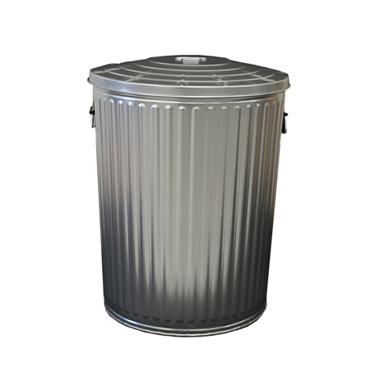


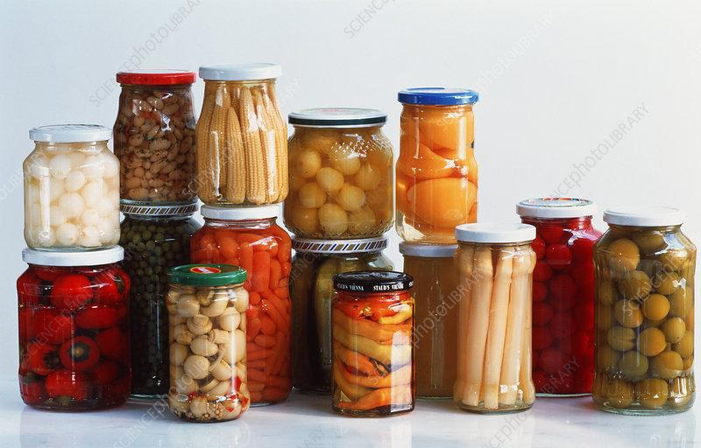



Food wastage can be avoided and prevented
Food that is preserved using various preservation methods can avoid and prevent waste from happening

Slide 4
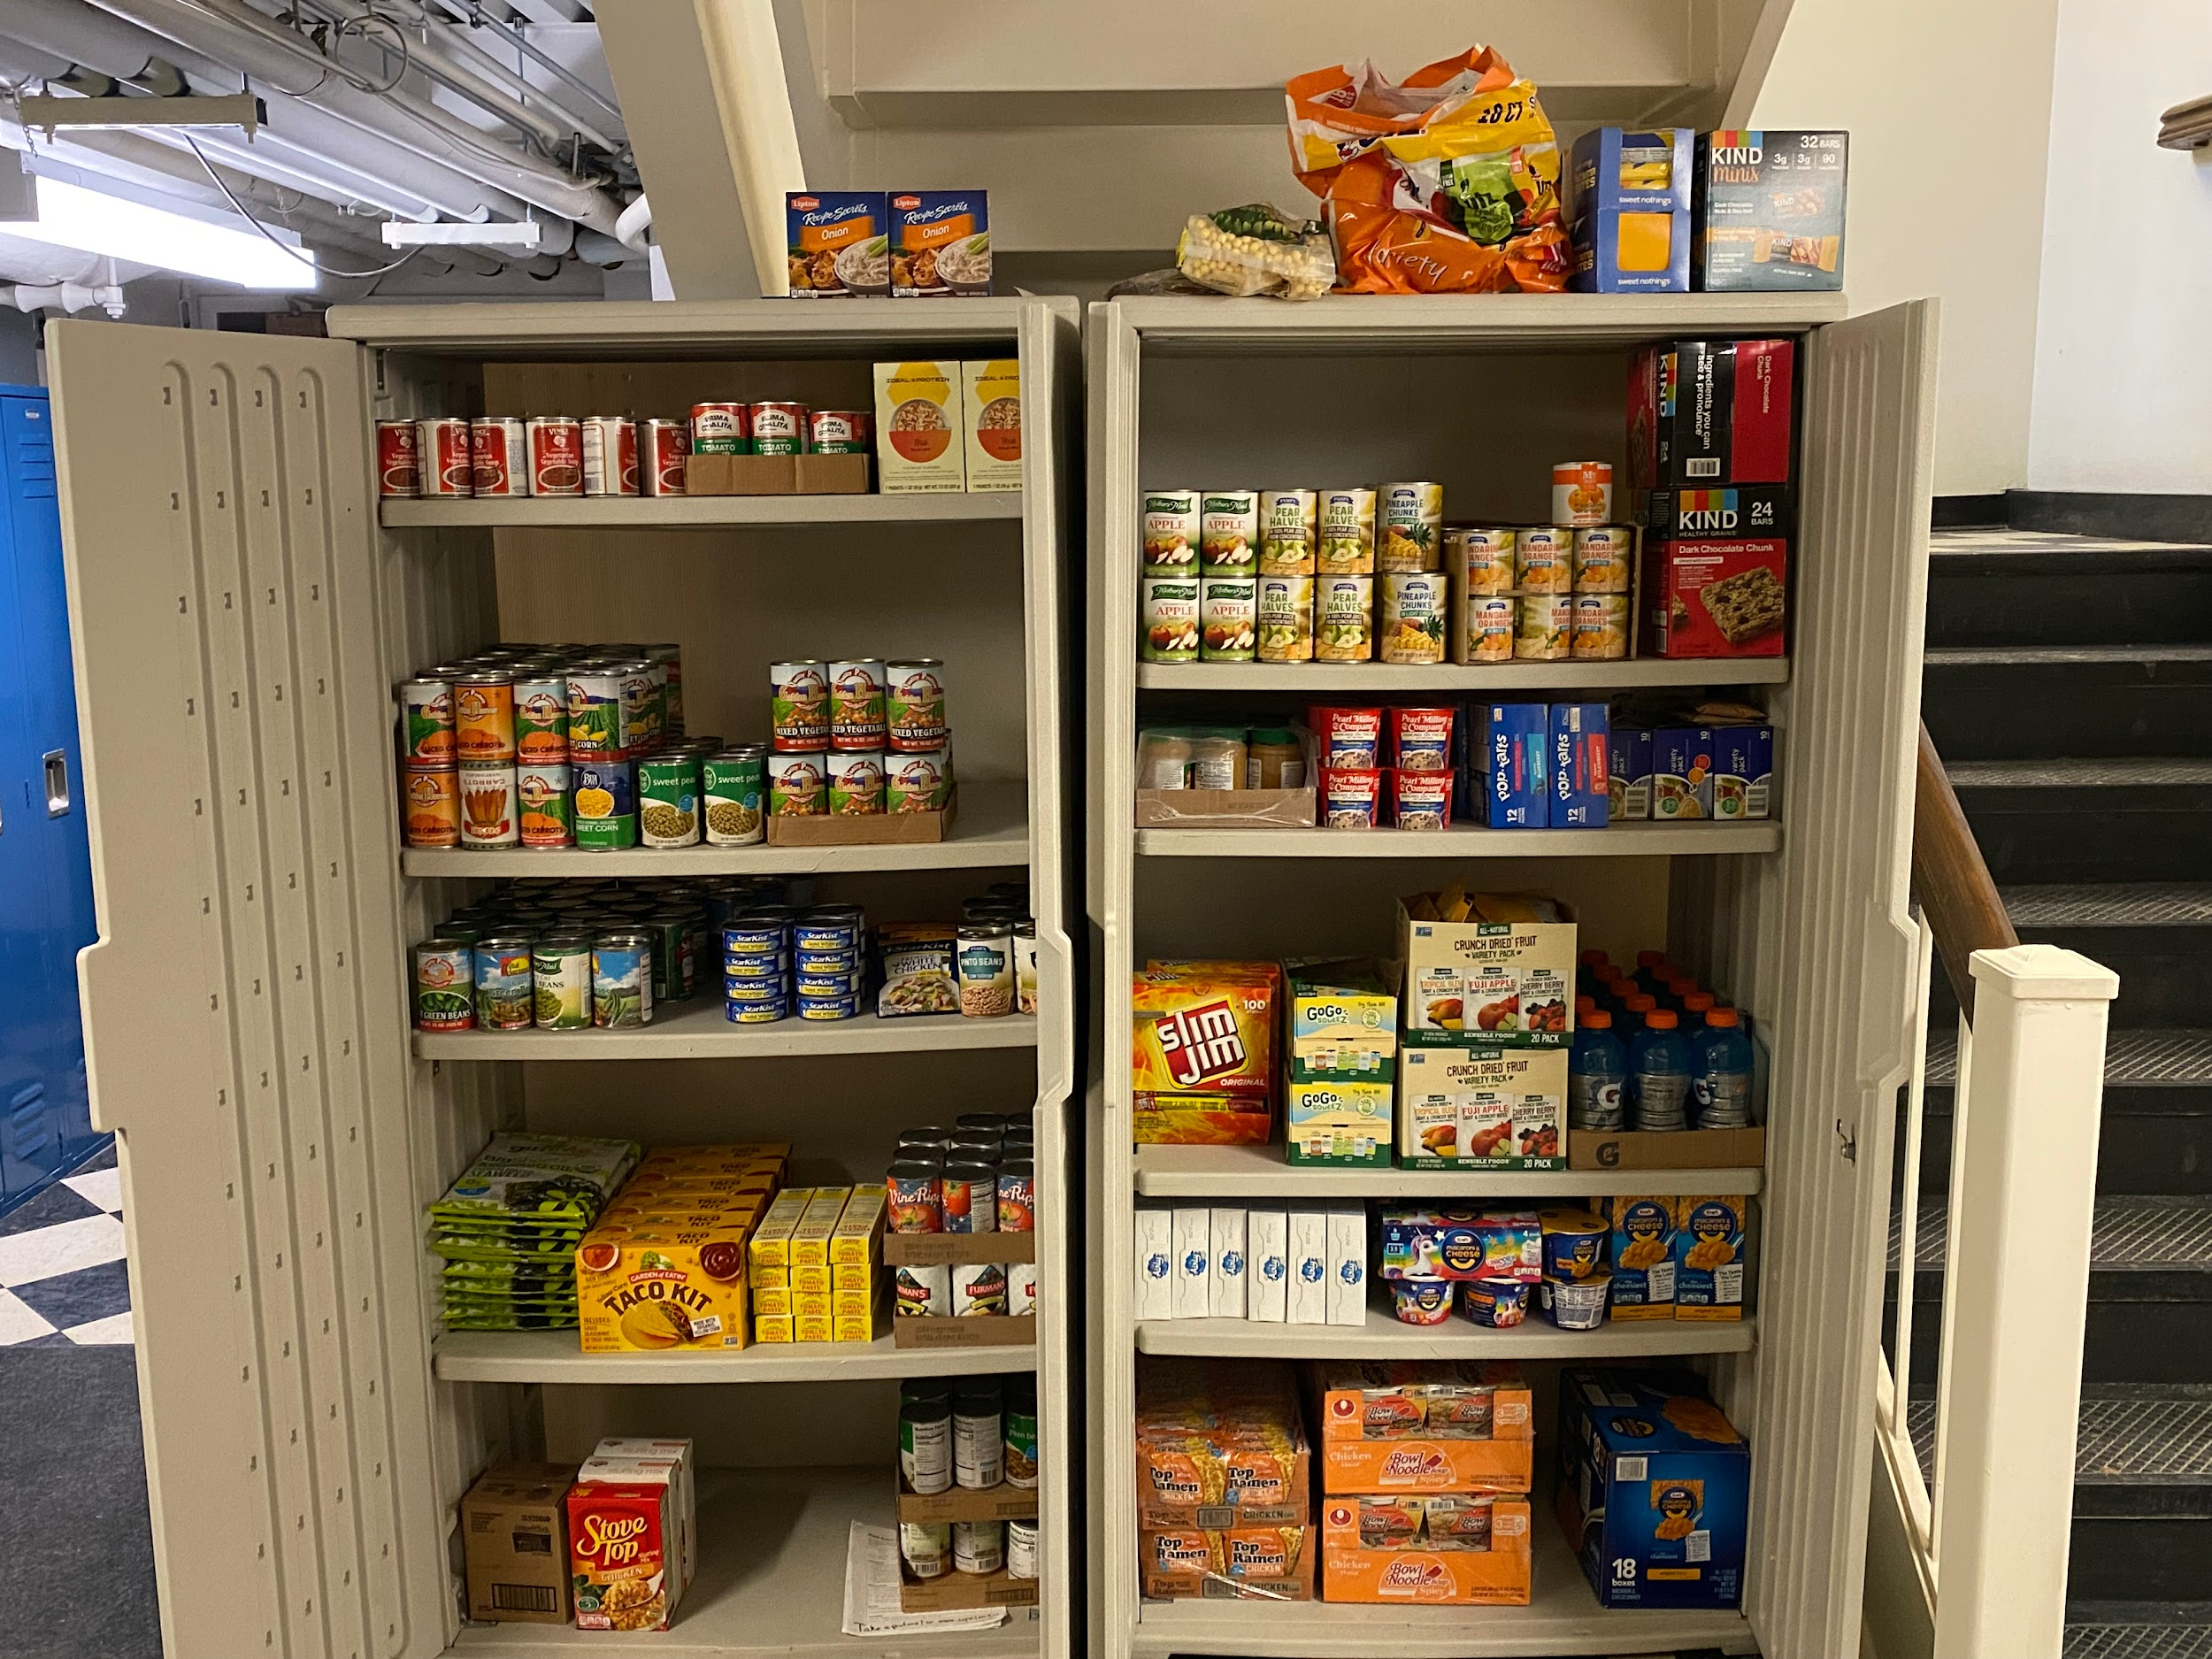




Food becomes easier to store
Food that is preserved through canning and bottling can save space and it is easier to store.

Slide 5
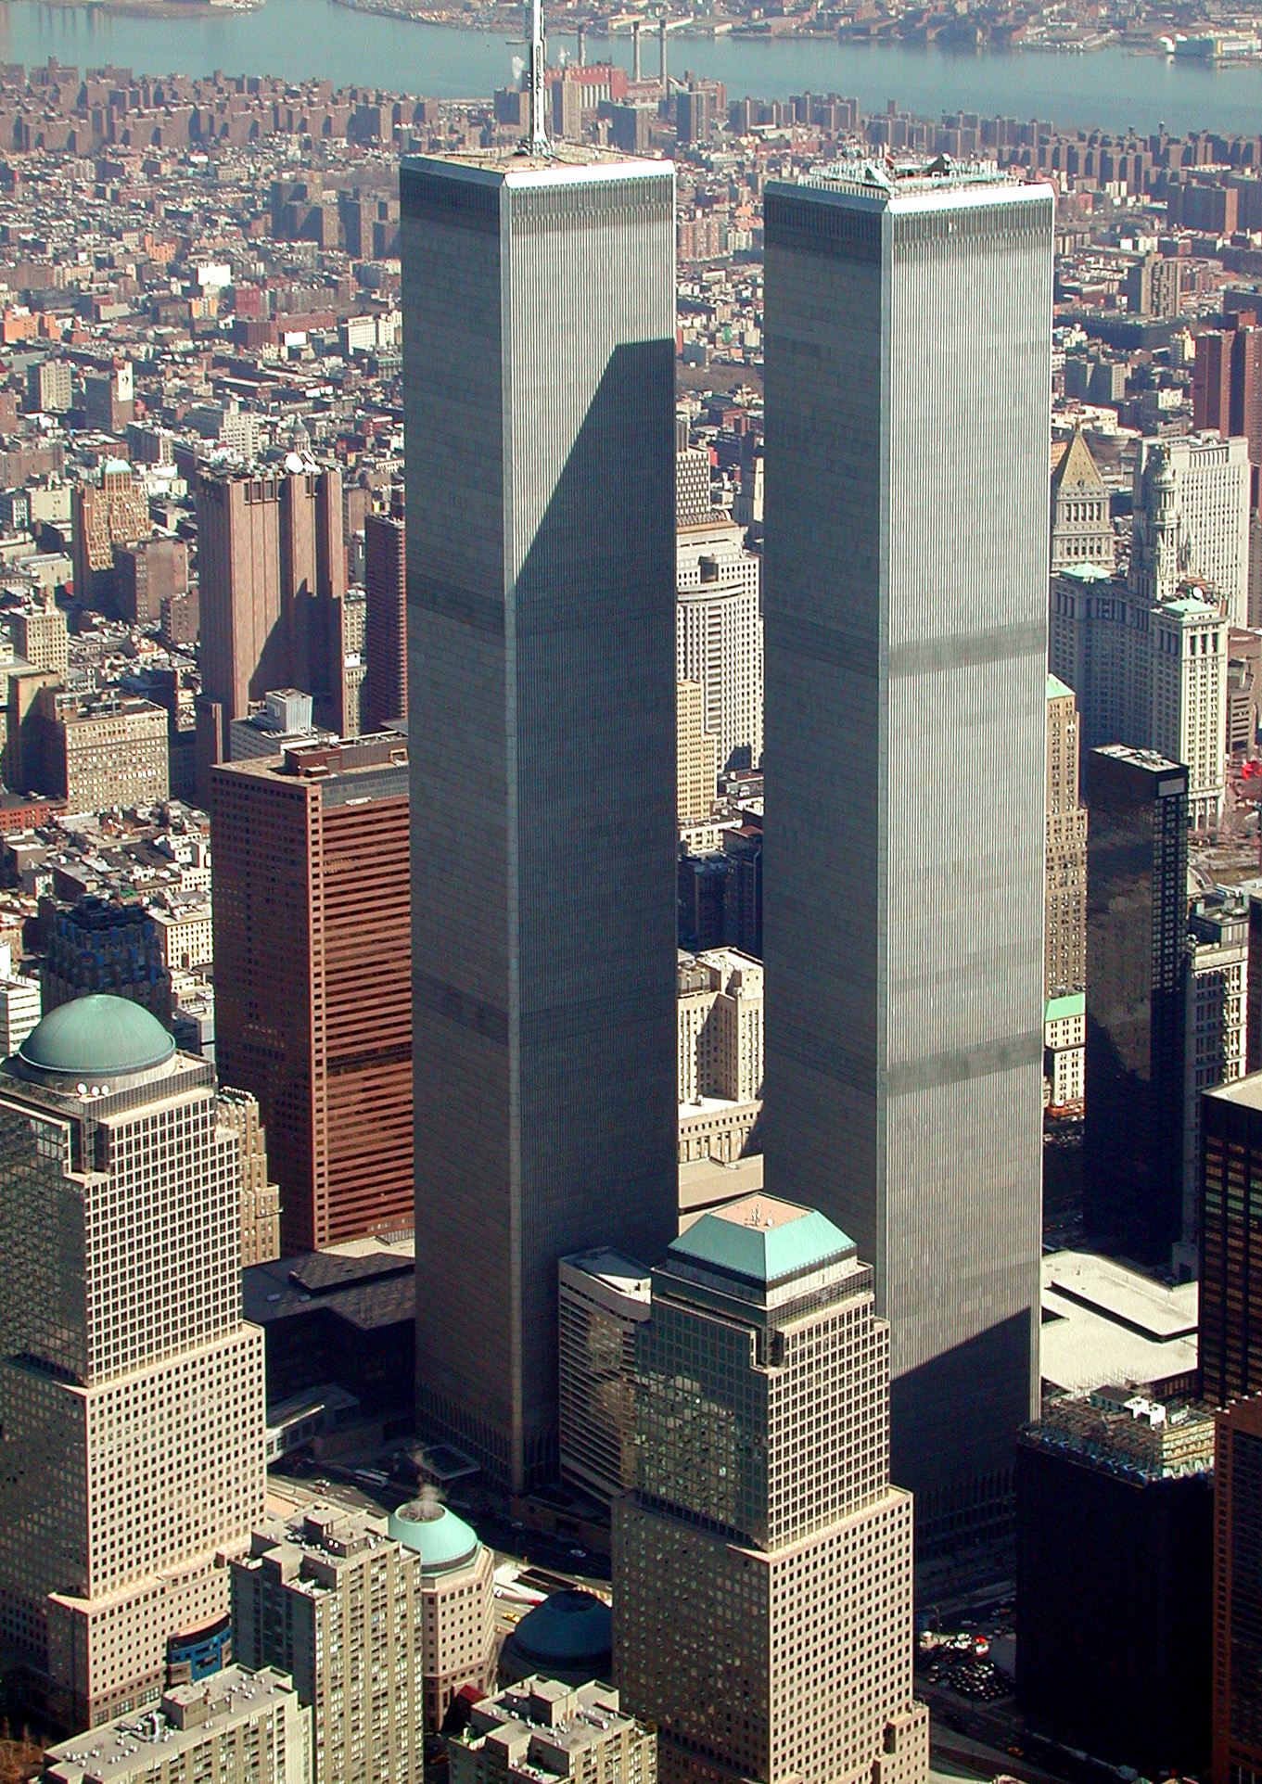
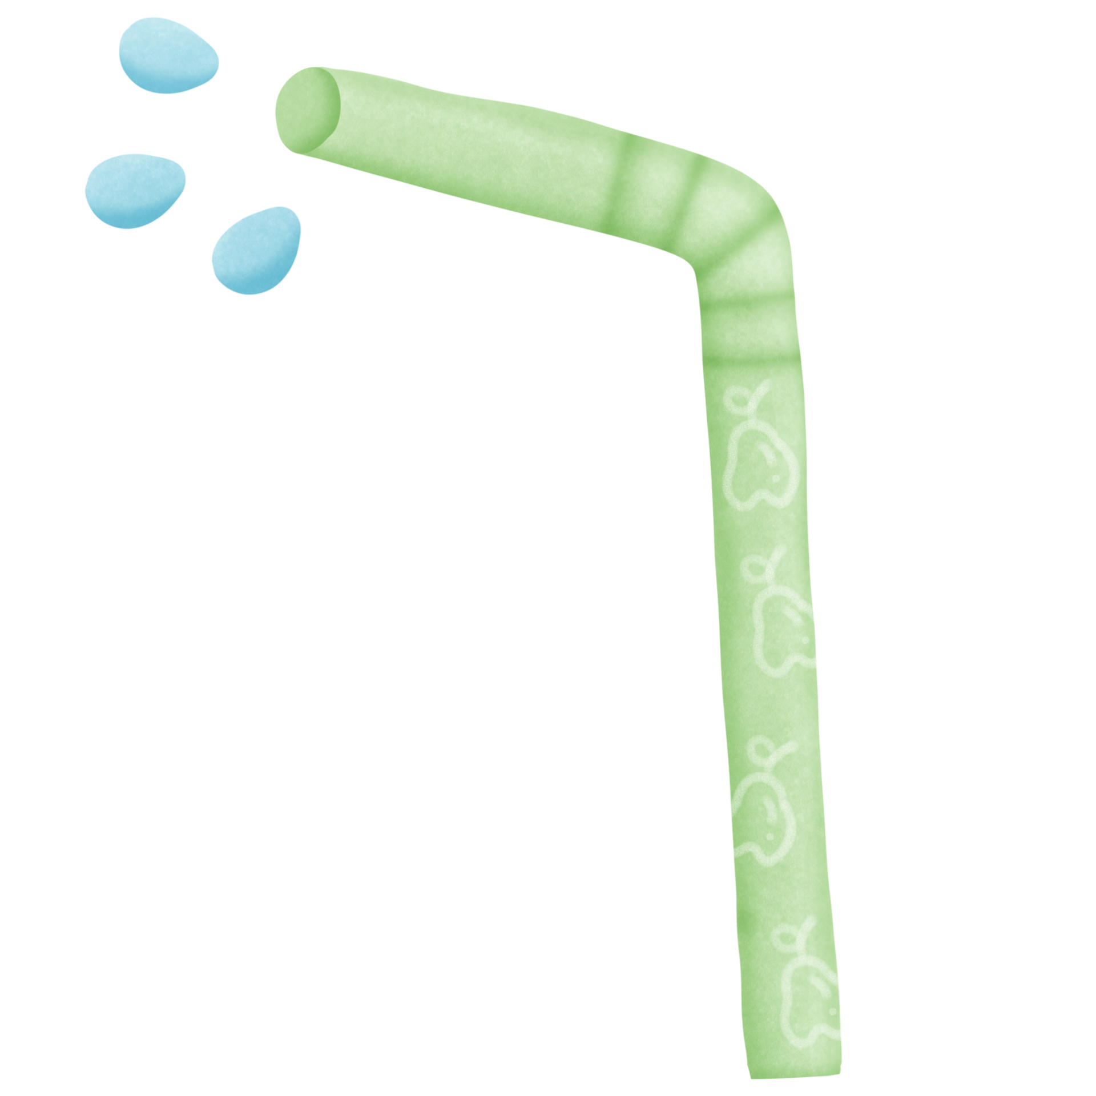
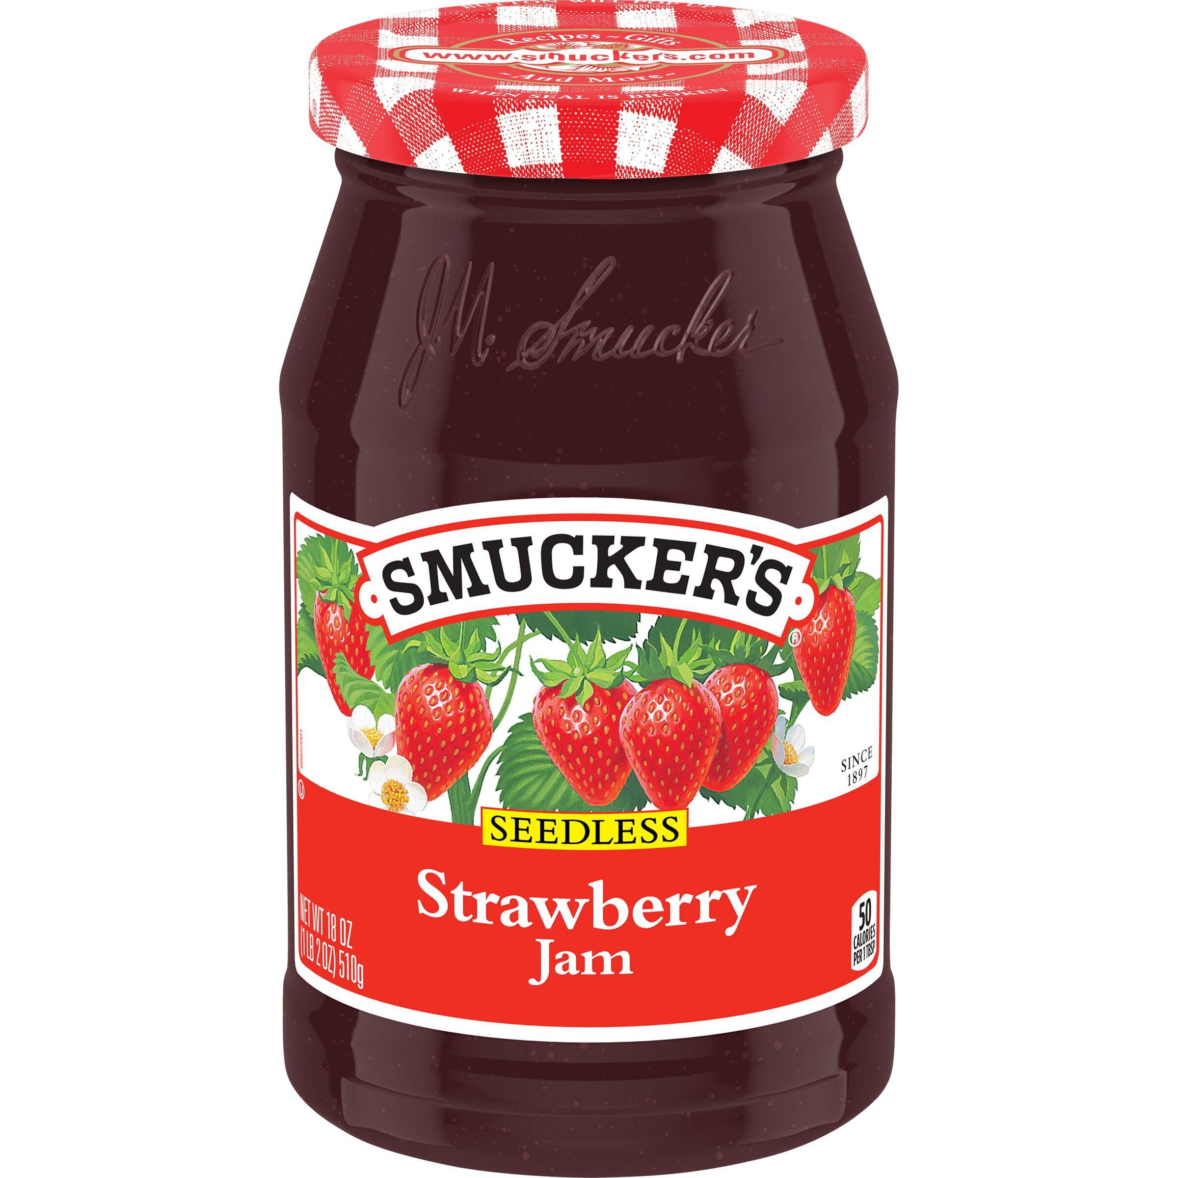

Continuous supply of out of season food
Seasonal foods can be preserved using various preservation methods so that they can be enjoyed throughout the year.

Slide 6


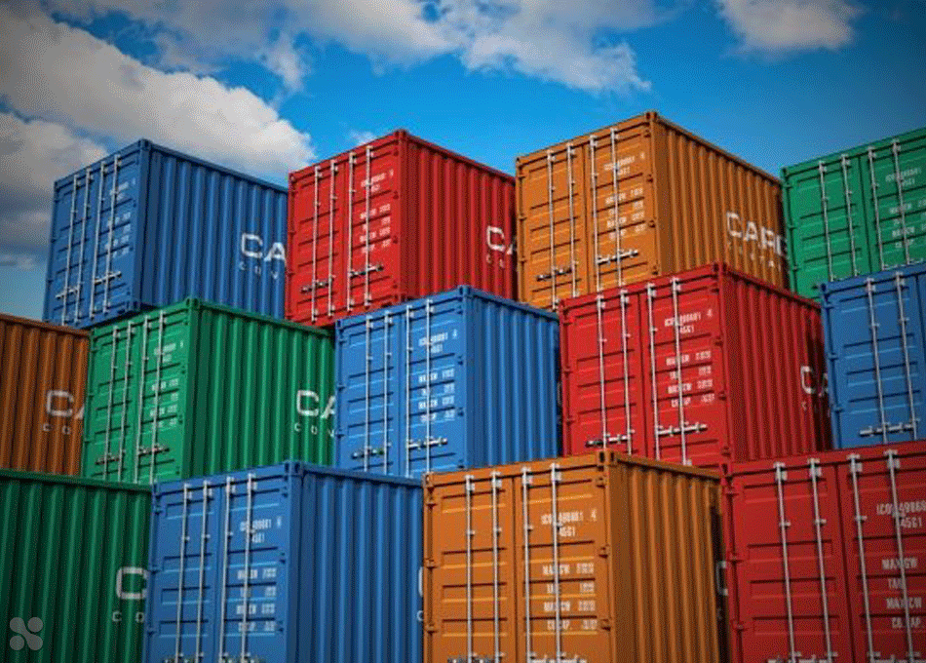
Food becomes easier to be exported
Food preservation technology allows food to be exported to other countries.

Slide 7

Production of instant food
Instant food that is preserved can ease the food supply management when food is limited especially during drought, winter or when natural disasters occur.

Slide 8
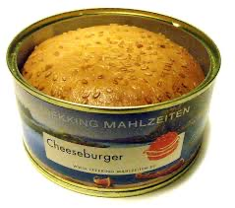


For example: Preserved food during natural disaster.

Slide 9



Nowadays, food preservation technology has helped to meet the demand for food supply in our daily lives. The importance of food preservation technology includes producing food with longer shelf lives, avoiding and preventing wastage, easier storing of food, ensuring supply of food that are out of season, making food easier to be exported, and producing instant food.

